Slide 1
Primal-Dual Methods for Convex and Non-Convex Optimization in Computer Vision
Jan Stühmer, Thomas Möllenhoff, Daniel Cremers
Technische Universität München, Germany

Slide 2
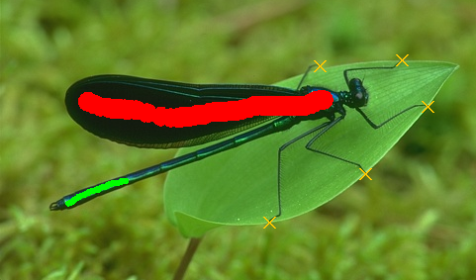
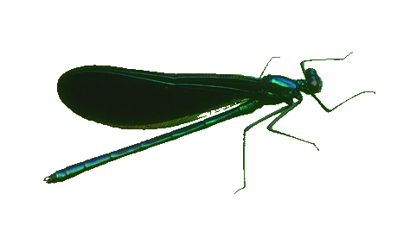

Connectivity Constraints in Segmentation and 3D Reconstruction
Given a pixel-wise probability model f, we wish to solve the
constrained optimization problem
where is a connected trajectory from the root node s to x.
The minimum Steiner tree problem can be reduced to this problem (Vicente et al. 2008).
→ This problem is NP hard

Slide 3

Approximation with a Shortest Path Tree
We propose to reformulate the connectivity constraint on the geodesic shortest path tree with given root node s:
this constraint can be introduced as a linear constraint in a convex optimization framework
Allows to compute a global optimal solution

Slide 4
Primal-Dual Splitting and Connectivity Constraints
Proximal Mapping by Projecting onto the Constraint Set
The update in the primal variable is defined as
By completing the square and further simplification we arrive at

Slide 5
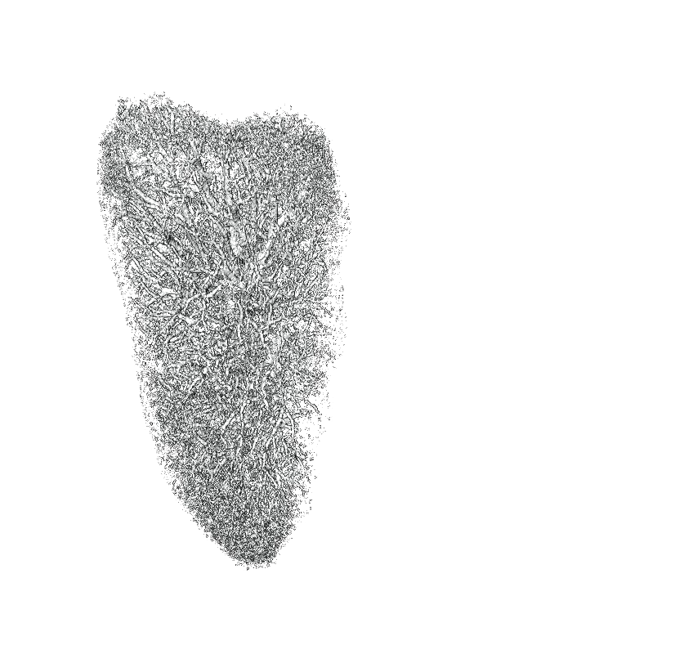
Example: Segmentation of Blood Vessels in the Lung
Total Variation image segmentation

Slide 6
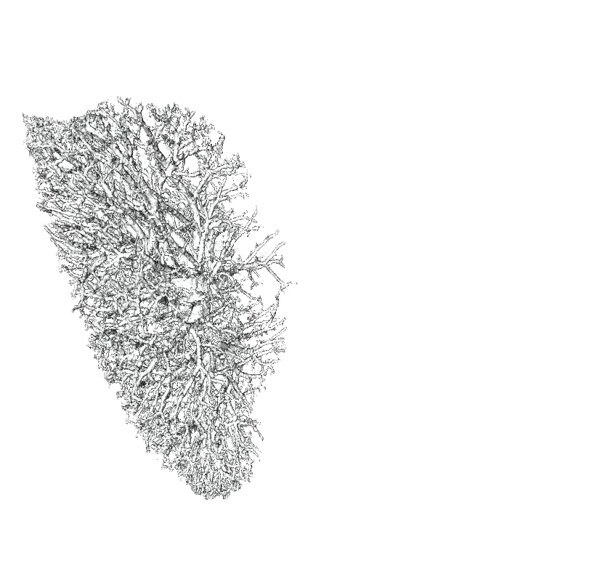
Example: Segmentation of Blood Vessels in the Lung
With Connectivity Constraint

Slide 7
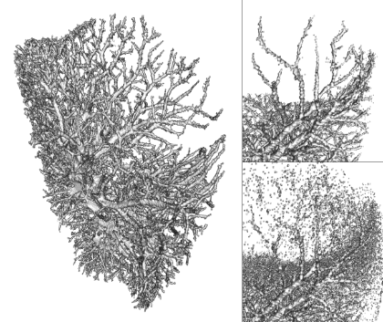
Connectivity Constraints in Image Segmentation
Stühmer, Schröder, Cremers, ICCV 2013
Stühmer, Cremers, EMMCVPR 2015

Slide 8

Connectivity Constraints in Multiview 3D Reconstruction
Oswald, Stühmer, Cremers, ECCV 2014

Slide 9

Connectivity Constraints in Multiview 3D Reconstruction
Variational Spatio-Temporal Regularization and Connectivity Prior
Jancosek and Pajdla CVPR‘11
Furukawa et al. PAMI‘11
Oswald and Cremers 4DMOD‘13
proposed
Oswald, Stühmer, Cremers, ECCV 2014

Slide 10
Nonconvex Primal-Dual Splitting
  Primal-dual splitting methods usually solve:
  The well-known „Chambolle-Pock“ algorithm reformulated for nonconvex functions F:
  Main theoretical contributions:
    We prove global convergence for a certain limited class of nonconvex functions F.
    Under weaker assumptions we can show boundedness and convergence to critical points along subsequences.

Slide 11
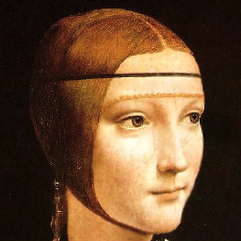
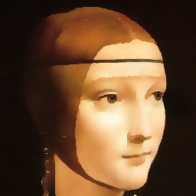



Application: Piecewise Smooth Mumford-Shah Functional
https://github.com/tum-vision/fastms
Möllenhoff, Strekalovskiy, Moeller, Cremers, SIAM J. Imaging Sciences 2015

